Slide 1
Cyber Security
-- By Dr. Shalu Chopra

Slide 2
What is Cyber Security
Cybersecurity is the practice of protecting systems, networks, and programs from digital attacks.
These cyberattacks are usually aimed at accessing, changing, or destroying sensitive information;
Extorting money from users through ransomware; or interrupting normal business processes.

Slide 3
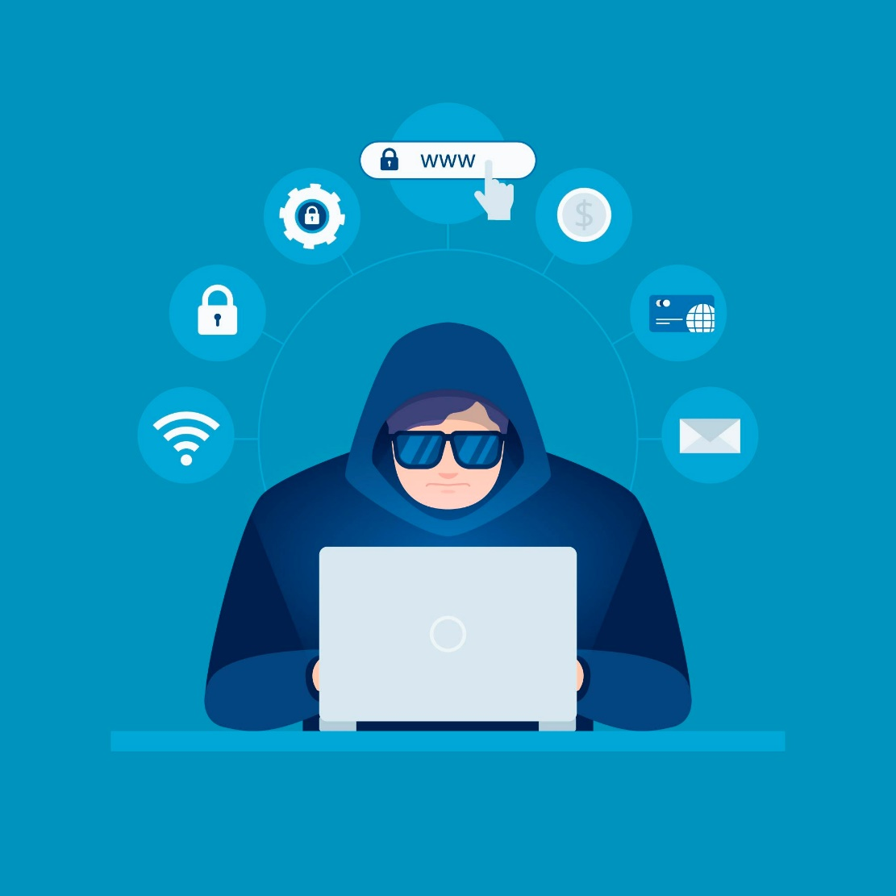
Agenda
01
What is a Cyber Attack?
02
Types of attacks :
web based attacks
system based attacks
03
Motive behind Cyber Attacks
04
How to secure your computer

Slide 4
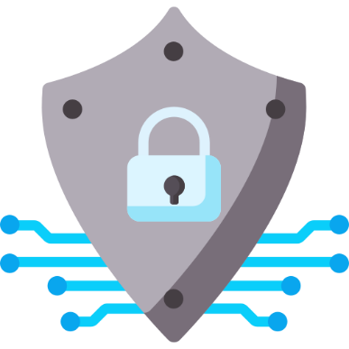
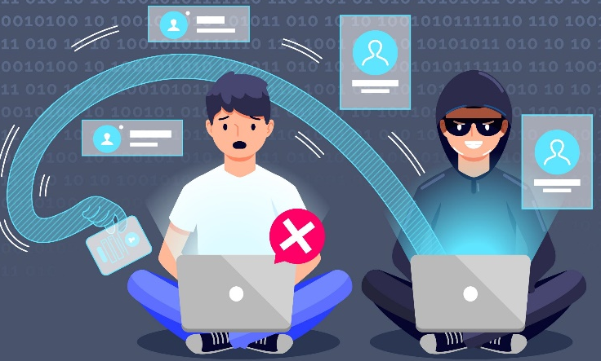
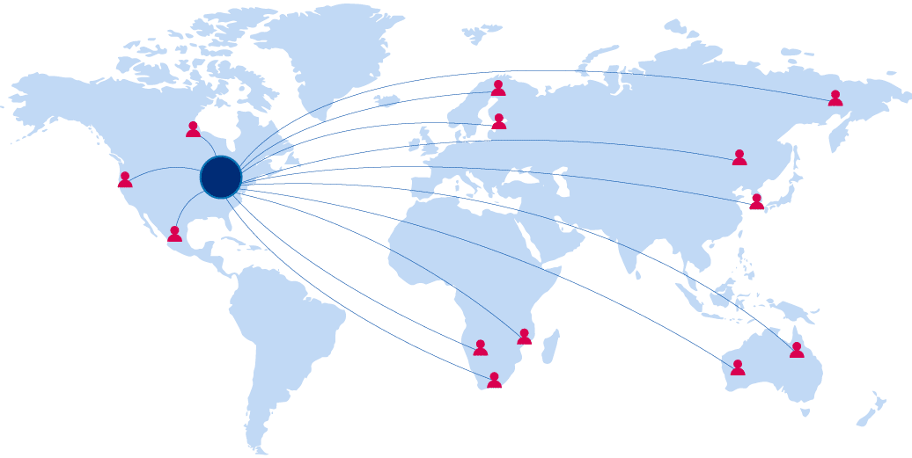
What is a Cyber Attack?
A cyber attack is done by cybercriminals using one or more computers to attack single or multiple computers or networks.
A cyber attack can disable computers, steal data, or use a breached computer as a launch point for other attacks.
A cyber attack can be executed from anywhere in the world using various attack strategies.

Slide 5
Types of Cyber Attacks

Slide 6

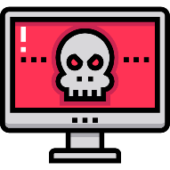


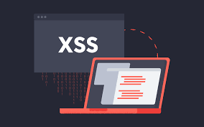
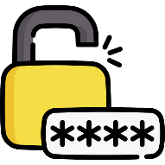


Types of Cyber Attacks : Web Based
Denial of Service
Dictionary attack/ Brute Force
Man in the middle
Phishing
Cross Site Scripting Attack
Password attack
SQL Injection
Social Engineering

Slide 7

Types of Cyber Attacks : System Based
Malware attack
Back doors
Trojan Horse
Bots
Virus/Worms

Slide 8


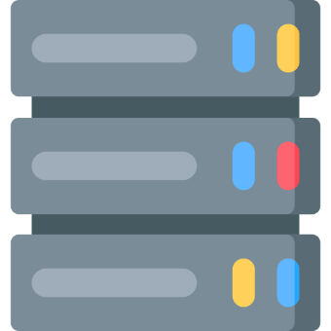
Types of Cyber Attacks : Web Based
To put it simply, distributed denial-of-service (DDoS) attack is an attempt to flood the server and overwhelming the target. Because of this, the service will temporarily not available or disrupted. The actual traffic will not be able to use the service because of this.
Denial of Service
Attacker
Control Server
Victim’s Server
Botnet of Infected Hosts

Slide 9
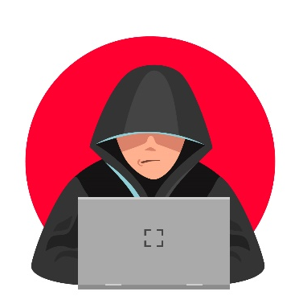
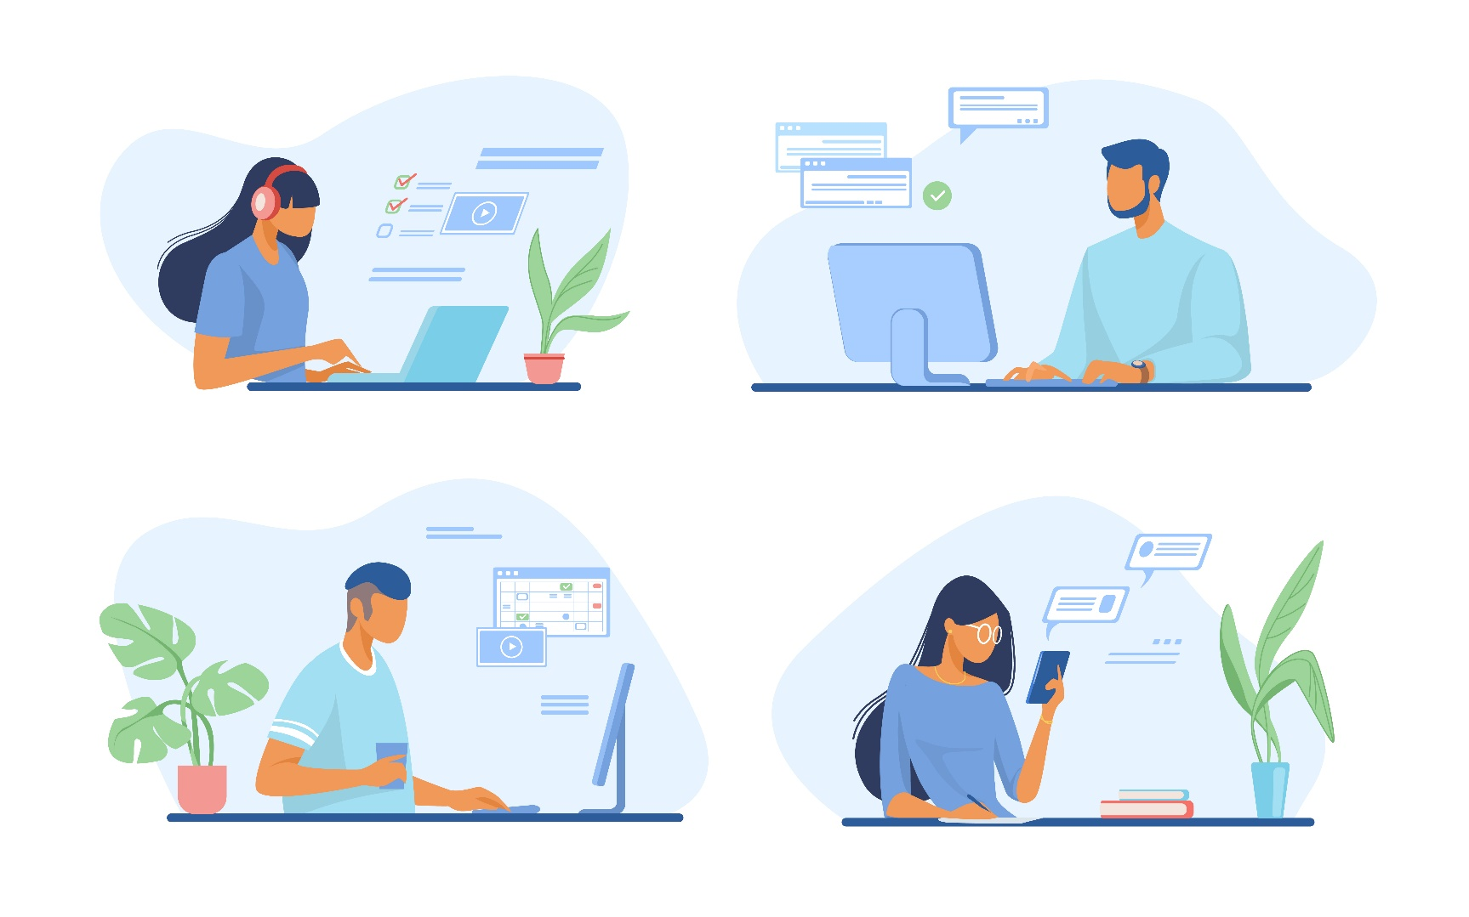
Types of Cyber Attacks : Web Based
A man-in-the-middle attack is where hackers interrupt an existing conversation or data transfer. This can happen in any form of online communication, such as email, web browsing, social media, etc.
Man in the middle

Slide 10
Types of Cyber Attacks : Web Based
In Phishing attacks, hackers send fraudulent messages that appear to come from a well known source. It is usually done through email. The goal is to steal sensitive data like credit card and login information.
Phishing
Dear customer,
You won 1Cr rupees through ABC Bank’s lucky draw. To transfer the money into your account, fill in the details that are present in the below link.
www.ABCbankreward.com
Thanks and Regards
ABC Bank

Slide 11

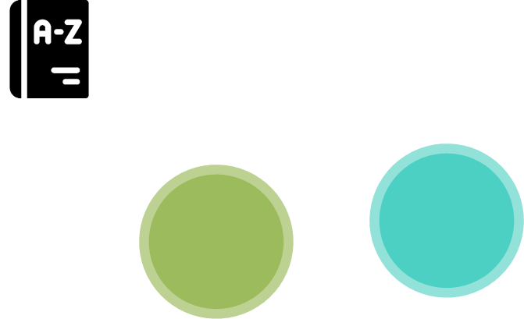


Types of Cyber Attacks : Web Based
Password attacks are the most common forms of corporate and personal data attacks. A password attack is simply when a hacker tries to steal your password.
Password attack
Brute force
Dictionary attack
Credential stuffing
Using Keyloggers

Slide 12
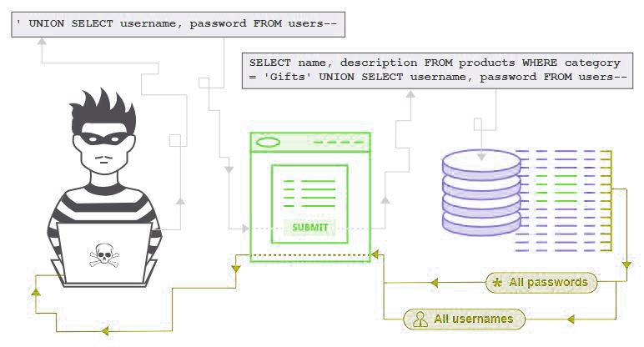
Types of Cyber Attacks : Web Based
SQL injection is a web security vulnerability in which, the attacker interferes with the queries that an application makes to its database. The hacker can retrieve sensitive data of the company.
SQL Injection

Slide 13
Types of Cyber Attacks : Web Based
Social Engineering uses psychological manipulation to trick users into giving away sensitive information to hackers. Then the hackers and use that information to breach personal or organizational devices.
Social Engineering

Slide 14





Types of Cyber Attacks : System Based
Malware is a malicious software designed to exploit any electronic device, service or network. Cybercriminals typically use it to extract data that they can leverage over victims for financial gain.
Malware attack
Viruses
Ransomware
Worms
Trojans
Adware
Spyware

Slide 15
Types of Cyber Attacks : System Based
Viruses
Malware attack
Virus : A computer virus is a self-replicating malicious computer program that replicates by inserting copies of itself into other computer programs when executed
It can also execute instructions that cause harm to system

Slide 16
Types of Cyber Attacks : System Based
Worm
Malware attack
Worm :: It works same as a computer virus
but it can spread into other systems in the network by exploiting the vulnerabilities automatically

Slide 17
Types of Cyber Attacks : System Based
Trojan horse
Malware attack
Trojan horse
It appears to be a normal application, but when opened/executed some malicious code will run in background
These are generally spread by some form of social engineering

Slide 18
Types of Cyber Attacks : System Based
Back Doors
Malware attack
Backdoors
Backdoor is a method of bypassing normal authentication process
The backdoor is written by the programmer who creates the code for the program
It is often only known by the programmer..

Slide 19
Types of Cyber Attacks : System Based
Bots
Malware attack
Bots: This is an automated process that interacts with other network services
Can be classified into
Spyware
Used to gather information of user without their knowledge. Ex: Keyloggers
Adware
Mainly used for promotions of products , Not so harmful

Slide 20
Types of Cyber Attacks : System Based
Ransomware
Malware attack
Ransomware is a type of malware attack in which the attacker locks and encrypts the victim’s data, important files and then demands a payment to unlock and decrypt the data.
This type of attack takes advantage of human, system, network, and software vulnerabilities to infect the victim’s device—which can be a computer, printer, smartphone, wearable, point-of-sale (POS) terminal, or other endpoint.
Ex. WannaCry, Cryptolocker

Slide 21
Types of Cyber Attacks : System Based
Other attacks
Malware attack
Spoofing
In spoofing, one person successfully impersonates as another by falsifying the data. Ex: IP spoofing, email spoofing etc.,
Sniffing
Sniffing a process of capturing and analyzing the traffic in a network
Port scanning
It is a method to probe a system for open ports
Intruder can exploit the vulnerabilities of open ports

Slide 22
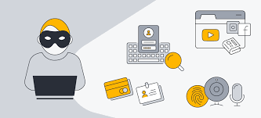
Types of Cyber Attacks : System Based
Spyware
Malware attack
Spyware is malicious software that enters a user's computer, gathers data from the device and user, and sends it to third parties without their consent. A commonly accepted spyware definition is a strand of malware designed to access and damage a device without the user's consent.

Slide 23
Motive behind a Cyber Attack

Slide 24
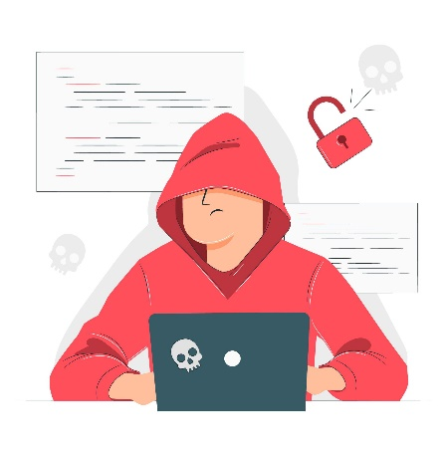
Motive behind a Cyber Attack
Financial loss to the target
Disrupting business continuity
Demanding Ransom
Propagating religious or political beliefs
Damaging reputation of target
Achieving state’s military objectives
Information theft and manipulating data
Creating chaos by disrupting critical infrastructure

Slide 25
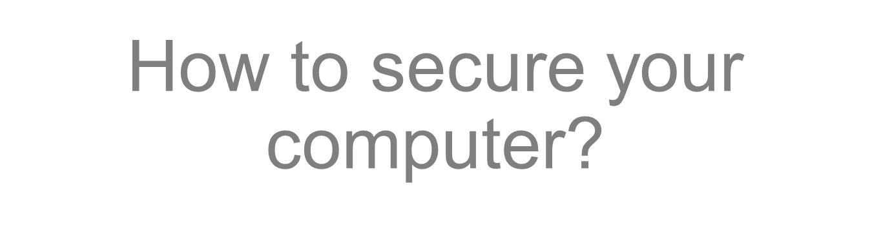

Slide 26
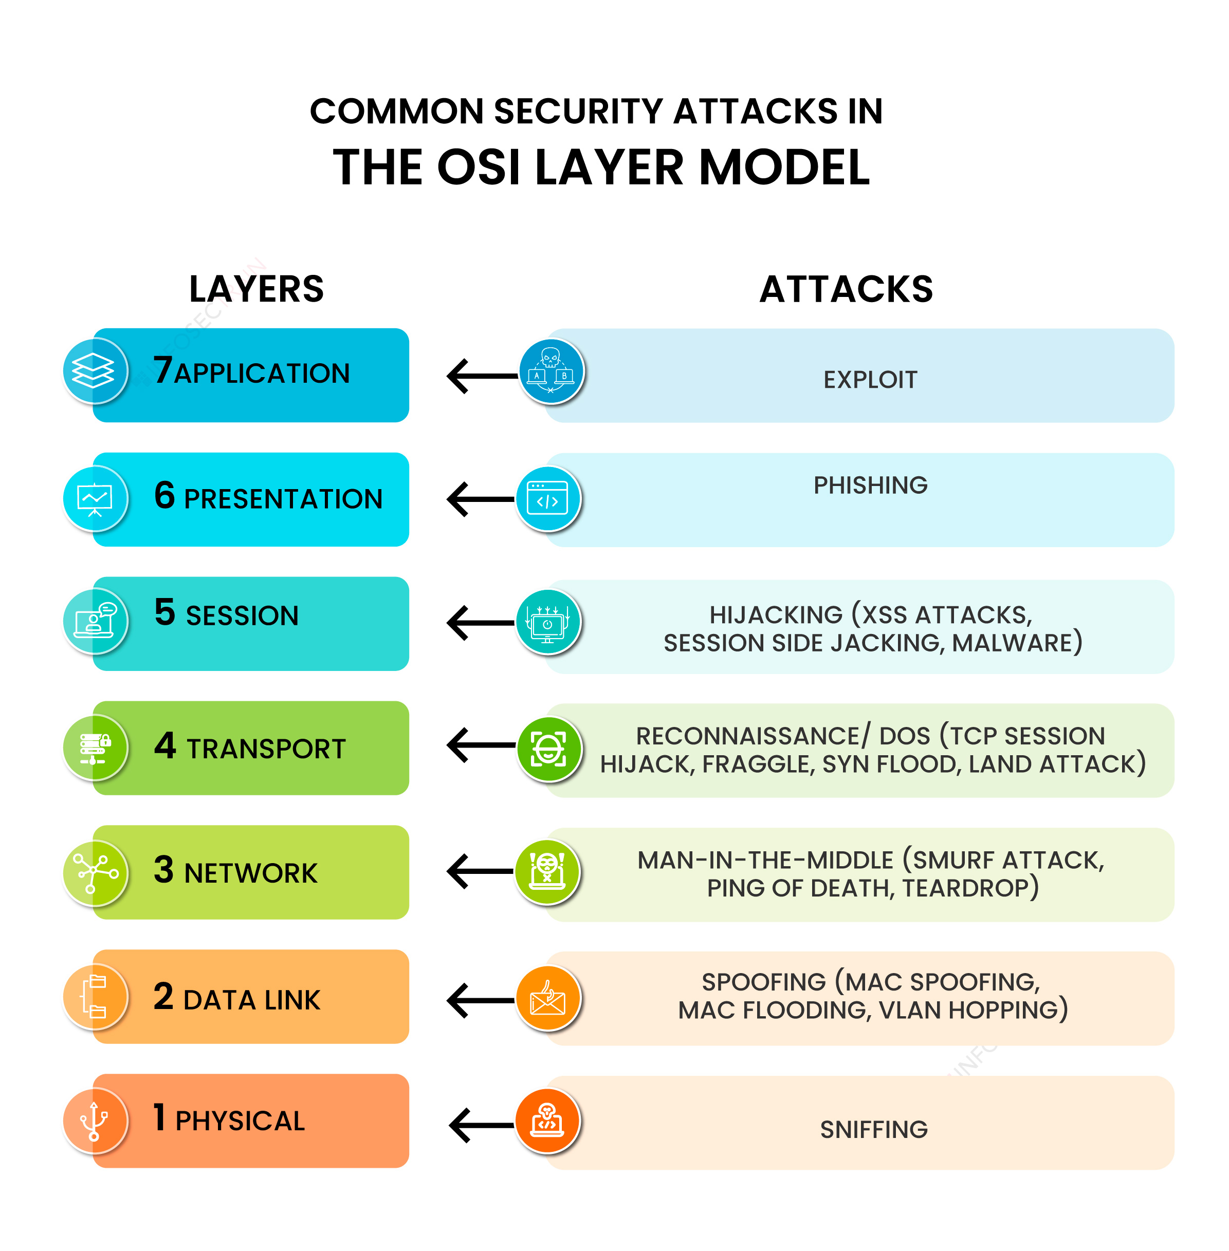

Slide 27
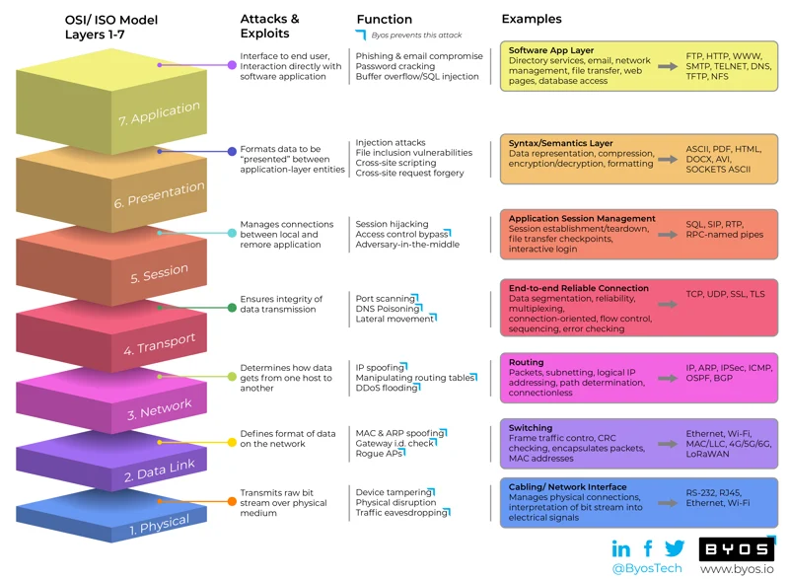

Slide 28
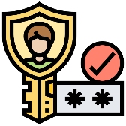
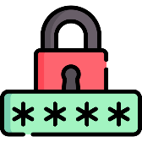





How to secure your Computer?
2-way authentication
Secure passwords
Regular updates
Antivirus
Enable firewall
Say NO to phishing

Slide 29
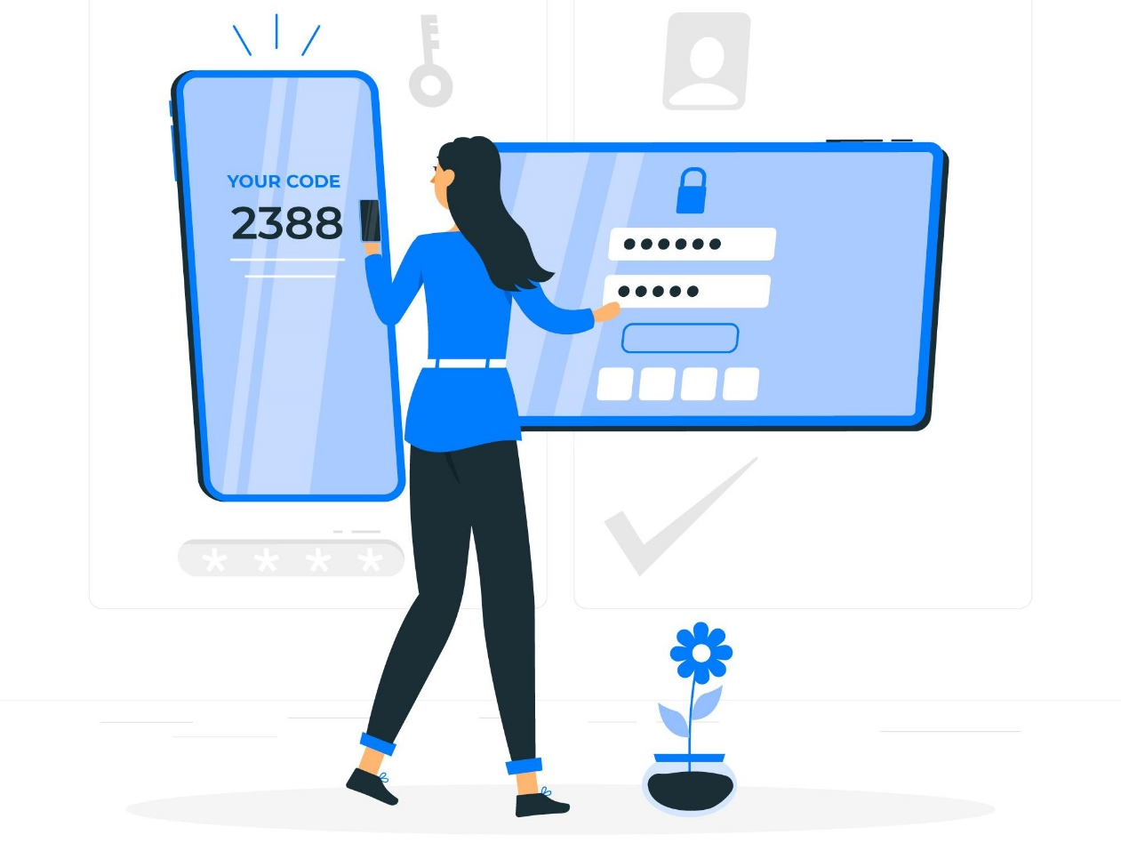
How to secure your Computer?
2-way authentication
It is an extra layer of security used to make sure that user trying to gain access to an online account is authentic.

Slide 30
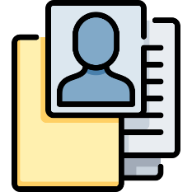



How to secure your Computer?
Secure passwords
Hackers are hungry for passwords as they have a lot of value. That’s the main reason companies ask you to create a strong password.
Do not use personal information
Create long passwords with mixed characters
Change passwords regularly
Do not write down your passwords

Slide 31
Use Strong Passwords
Make passwords easy to remember but hard to guess
USG standards:
Be at least ten characters in length
Must contain characters from at least two of the following four types of characters:
English upper case (A-Z)
English lower case (a-z)
Numbers (0-9)
Non-alphanumeric special characters ($, !, %, ^, …)
Must not contain the user’s name or part of the user’s name
Must not contain easily accessible or guessable personal information about the user or user’s family, such as birthdays, children’s names, addresses, etc.

Slide 32

How to secure your Computer?
Regular updates
Always update your computer as soon as update comes. An update comes when there is security issue and has been resolved.

Slide 33
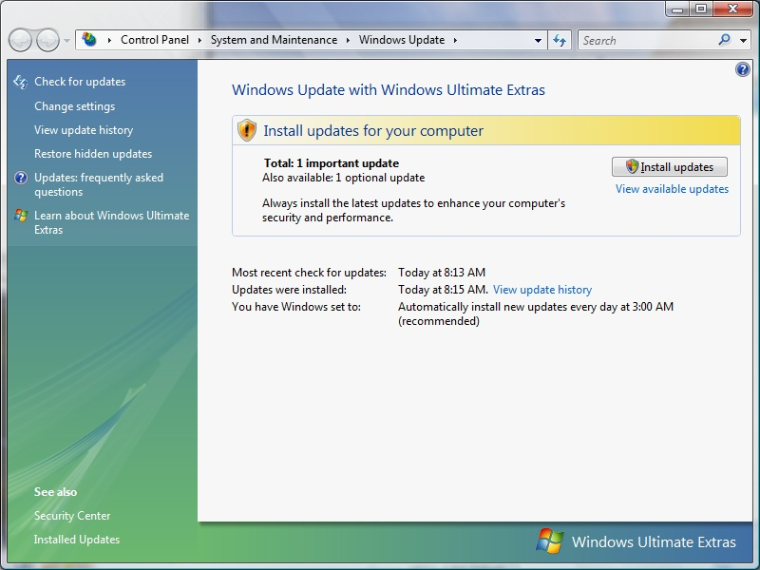

Protect your Operating System
Microsoft regularly issues patches or updates to solve security problems in their software. If these are not applied, it leaves your computer vulnerable to hackers.
The Windows Update feature built into Windows can be set up to automatically download and install updates.
Avoid logging in as administrator
Apple provides regular updates to its operating system and software applications.
Apply Apple updates using the App Store application.

Slide 34
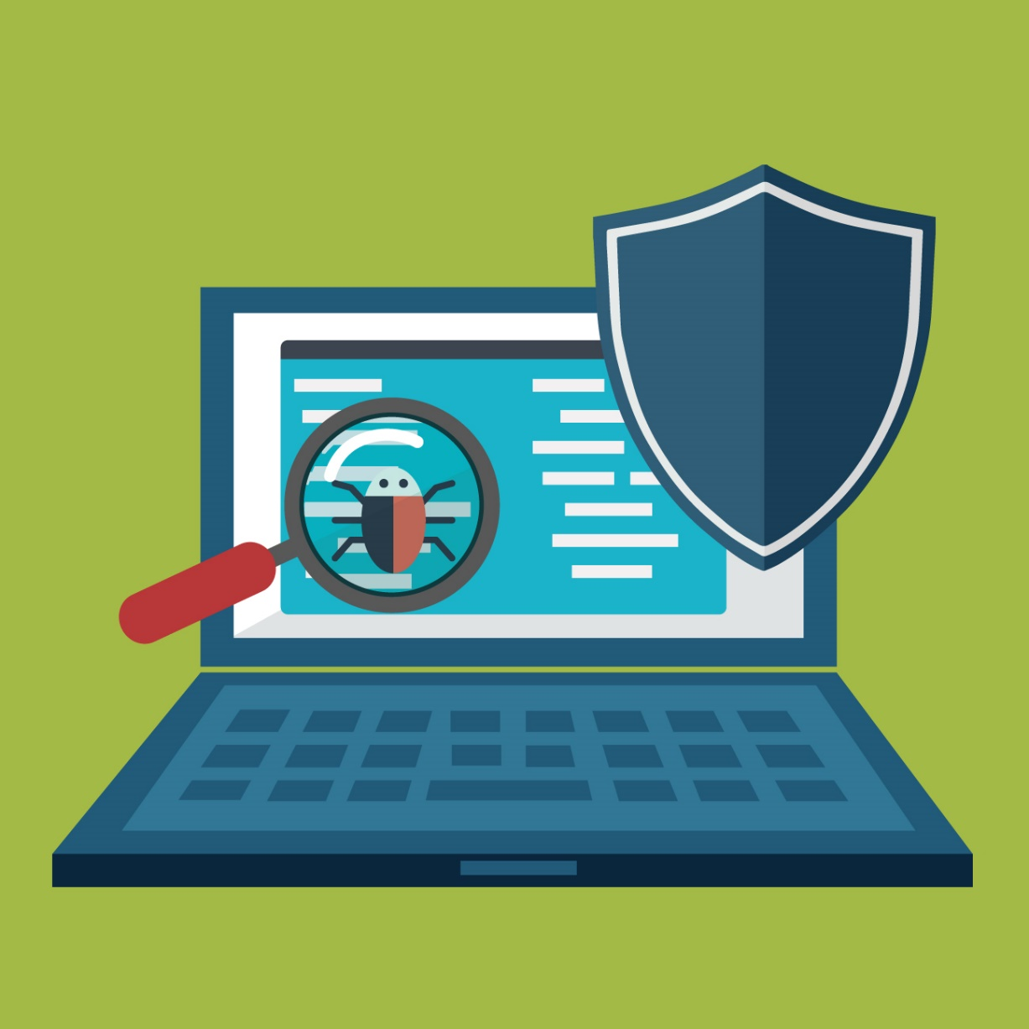
How to secure your Computer?
Antivirus
Always use and antivirus on your computer. It helps to detect any virus in the file that you download or get externally.

Slide 35
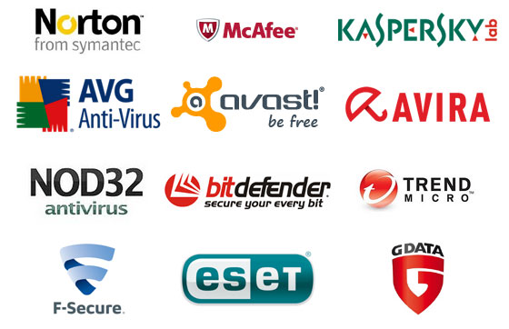
Anti-virus and Anti-spyware Software
Anti-virus software detects certain types of malware and can destroy it before any damage is done.
Install and maintain anti-virus and anti-spyware software.
Be sure to keep anti-virus software updated.
Many free and commercial options exist.
Contact your Technology Support Professional for assistance.

Slide 36
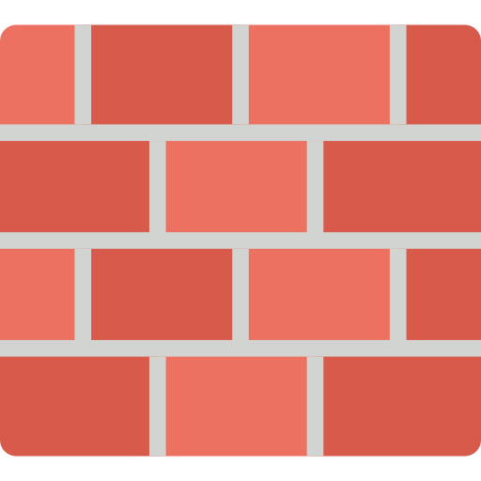
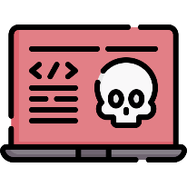




How to secure your Computer?
Enable firewall
A firewall is a network security device. It helps in filtering or blocking incoming and outgoing network traffic based on the organizations policies.
The Internet
Private Network
Firewall
Attackers

Slide 37

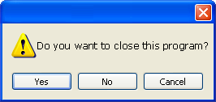
Avoid Hacker Tricks
Be sure to have a good firewall or pop-up blocker installed.
Pop-up blockers do not always block ALL pop-ups so always close a pop-up window using the ‘X’ in the upper corner.
Never click “yes,” “accept” or even “cancel.”
Infected USB drives are often left unattended by hackers in public places.

Slide 38

How to secure your Computer?
Say NO to phishing
This is the most common way to get credentials from any user. It is important to have awareness about this attack to protect yourself and your organization.
Do no click on any links given in email.
Do not open any attachment from the email coming from unknown source.
Do no enter personal information on pop-up screens.
Install a Phishing filter on your email.

Slide 39

Avoid Social Engineering and Malicious Software
Do not open email attachments unless you are expecting the email with the attachment and you trust the sender.
Do not click on links in emails unless you are absolutely sure of their validity.
Only visit and/or download software from web pages you trust.

Slide 40

Backup Important Information
No security measure is 100% reliable.
Even the best hardware fails.
What information is important to you?
Is your backup:
Recent?
Off-site & Secure?
Process Documented?
Encrypted?
Tested?

Slide 41
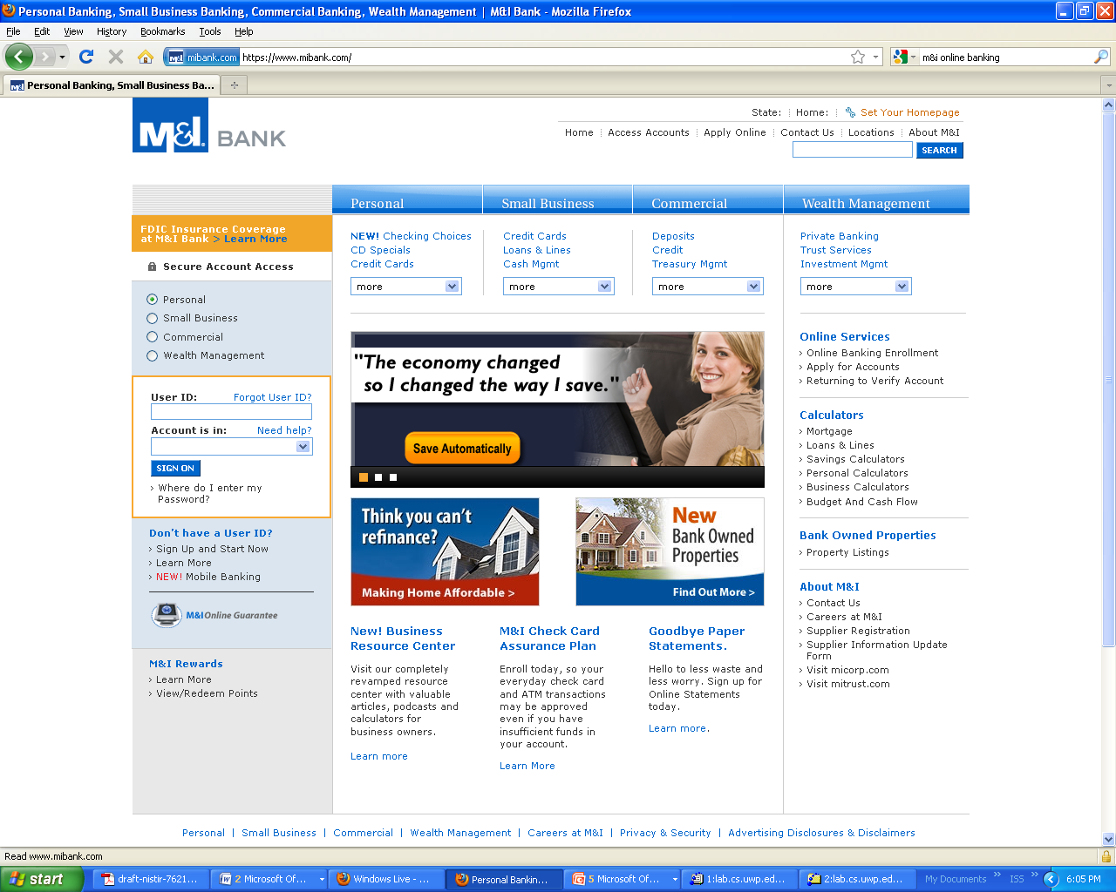
Secure Business Transactions
https://
Symbol indicating
enhanced security

Slide 42
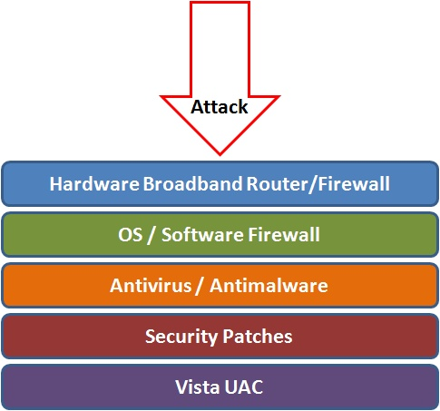
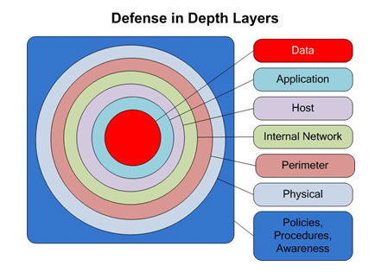
Best Practices to avoid these threats
Defense in depth uses multiple layers of defense to address technical, personnel and operational issues.
User Account Controls

Slide 43
Thank You!

